Slide 1

EWRI 2026
AI & Machine Learning Training Workshop for Water Resources & Environmental Applications
Convolutional Neural Networks
Recurrent Neural Networks
Transformers
Graph Neural Networks
Mixture-of-Experts
Instructor: Wenqian (Wendy) Dong
Assistant Professor @ Computer Science
Oregon State University
https://cybertraining.dk-lab.xyz/workshop/ewri-2026

Slide 2
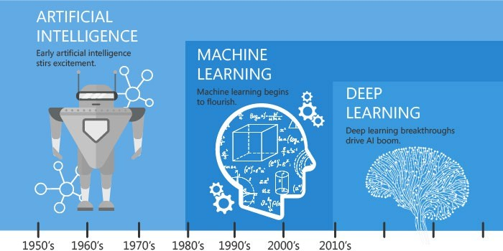
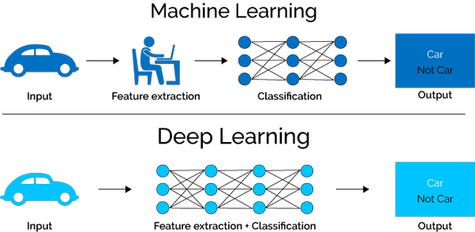
What is Machine Learning and Deep Learning?
Machine Learning (ML)
“the study of computer algorithms to improve automatically through experience and use of data”
Deep Learning (DL) – a subset of ML
Uses Deep Neural Networks (DNNs)
Perhaps, the most revolutionary subset!
Based on learning data representation
DNN Examples: Convolutional Neural Networks, Recurrent Neural Networks, Hybrid Networks
Data Scientist or Developer Perspective for using DNNs
Identify DL as solution to a problem
Determine Data Set
Select Deep Learning Algorithm to Use
Use a large data set to train an algorithm
Courtesy: https://hackernoon.com/difference-between-artificial-intelligence-machine-learning-and- deep-learning-1pcv3zeg, https://blog.dataiku.com/ai-vs.-machine-learning-vs.-deep-learning, https://en.wikipedia.org/wiki/Machine_learning

Slide 3
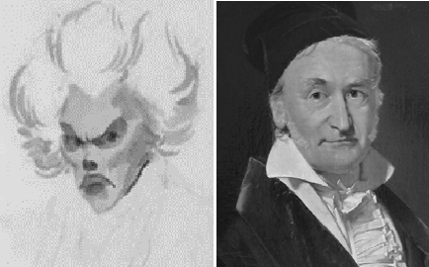
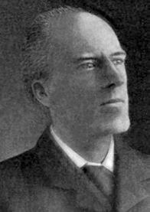
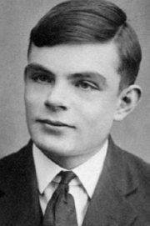
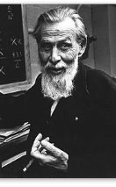
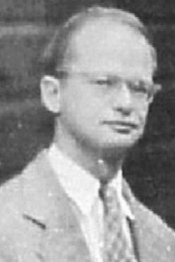
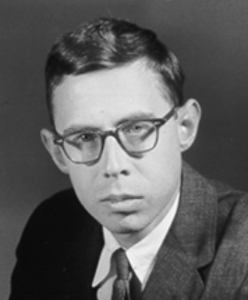
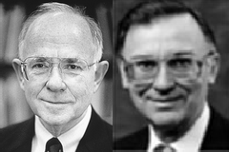
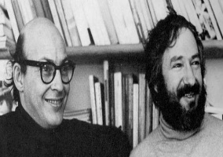
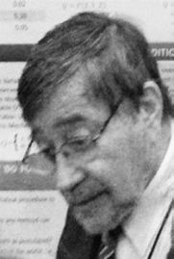

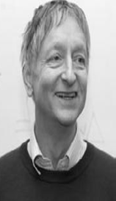
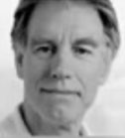
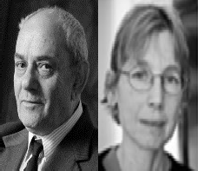

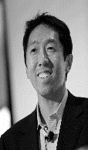

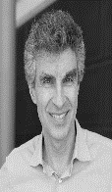
History: Milestones in the Development of ML/DL
XOR
Problem
Multi-layered
Perceptron (Backpropagation)
AlexNet
ADALINE
WGAN
Perceptron
ResNet
Golden Age
Dark Age (“AI Winter”)
DBN
Electronic Brain
Transformers
1943
1957
1960
1969
1986
2006
2012 2015 2017
1800
1900
….
1940 1950
1936 1954
1960
1970
1980
1990
2000
1995 2000
2010
2020
1805
1901
1965
1967
1979
1985
2014
2017
Bayesian Network
Deep Forest
Linear Regression
K-Means
Turing Machine
SVM XGBoost Random Forest
KNN
PCA
Evolutionary Algorithms
Decision Trees
CatBoost
A. Legendre – J. Gauss
K. Pearson
A. Turing S. McCulloch – W. Pitts F. Rosenblatt
B. Widrow – M. Hoff
M. Minsky – S. Papert
J. Pearl
D. Rumelhart – G. Hinton – R. Wiliams
V. Vapnik– C. Cortes A. Krizhevsky
A. Ng
Y. LeCun
Y. Bengio

Slide 4
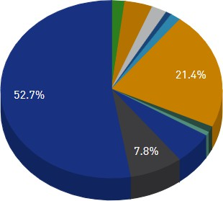
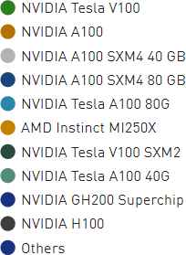
DL and High-Performance Architectures
NVIDIA GPUs are the main driving force for faster training of DL models
The ImageNet Challenge - (ILSVRC) -- 90% of the teams used GPUs (2014)*
Kaggle is a community for ML and data science and known for hosting competitions:
Provides free GPU access to participants due to wide acceptance by the community
However, High Performance Architectures for DL and HPC are evolving
194/500 Top HPC systems are using accelerator/co-processor (June ’24)
DGX-1 (Pascal), DGX-2 (Volta), DGX A100, DGX H100, HGX A100, HGX H100
Dedicated DL supercomputers
NVIDIA Eos – An Exaflop AI Supercomputer using DGX H100 (Announced)
Sapphire Rapids Xeon CPUs have 52 cores/socket (Aurora – #2 on Top500)
AMD EPYC (Rome/Milan) CPUs have 64 cores/socket (Frontier – #1 on Top500)
AMD Instinct MI250X GPUs power Frontier – the #1 Top500 DOE’s Exascale System at ORNL
Domain Specific Accelerators for DNNs are also emerging
Accelerator/CP Performance Share www.top500.org
*https://blogs.nvidia.com/blog/2014/09/07/imagenet/

Slide 5
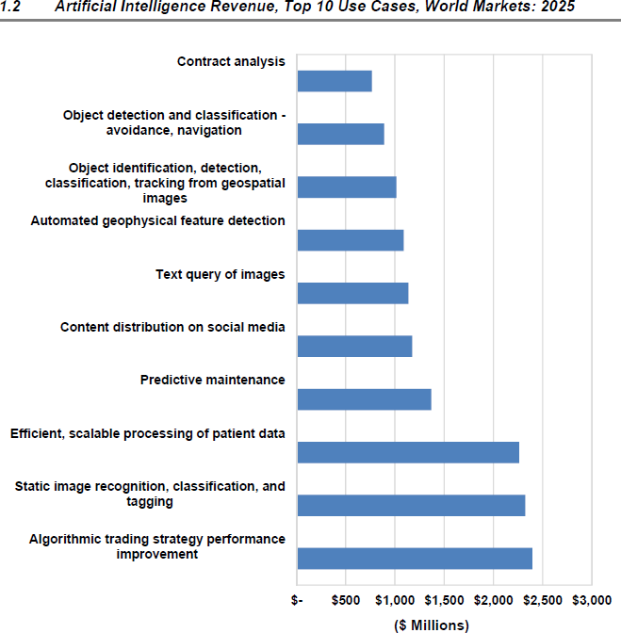
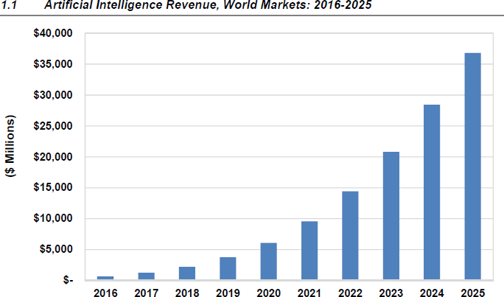
Artificial Intelligence Use Cases and Growth Trends
Courtesy: https://www.top500.org/news/market-for-artificial-intelligence-projected-to-hit-36-billion-by-2025/

Slide 6
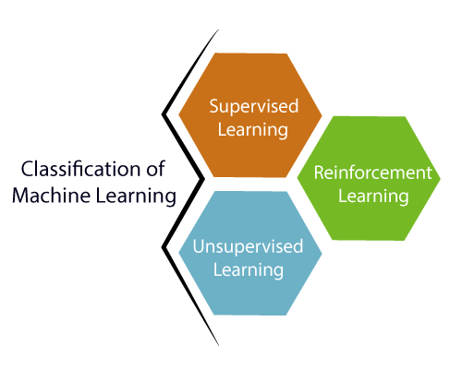
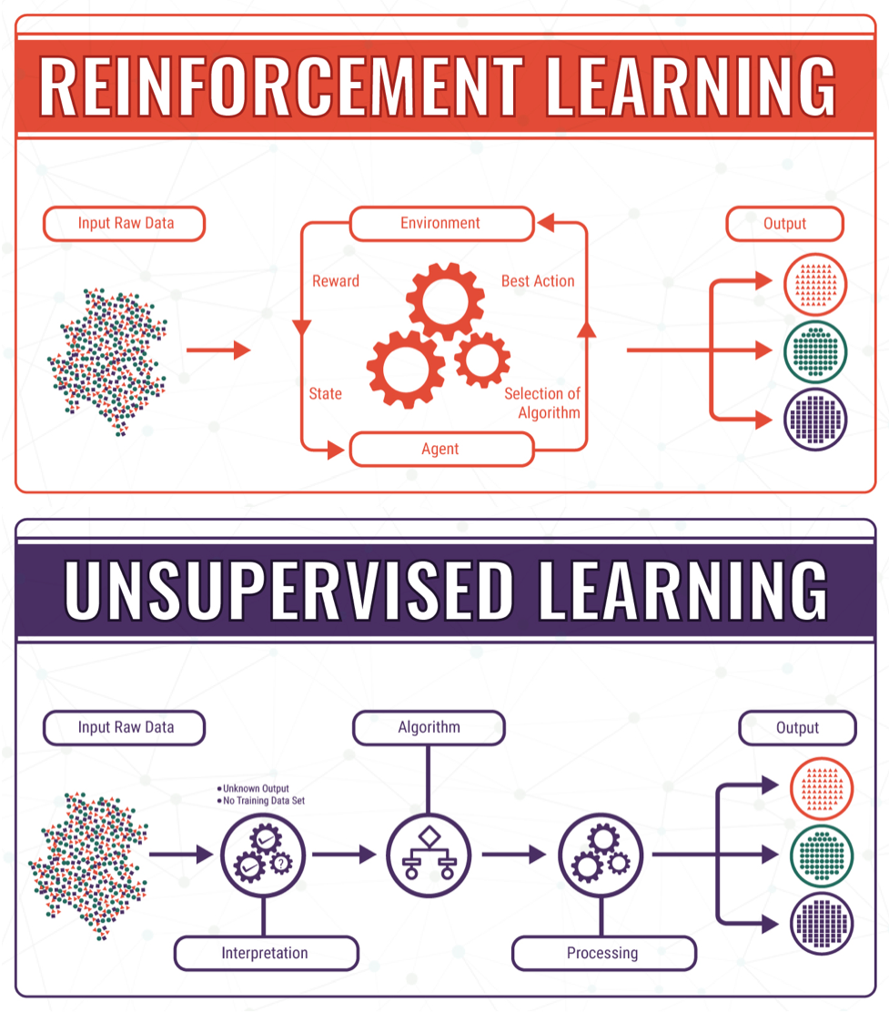
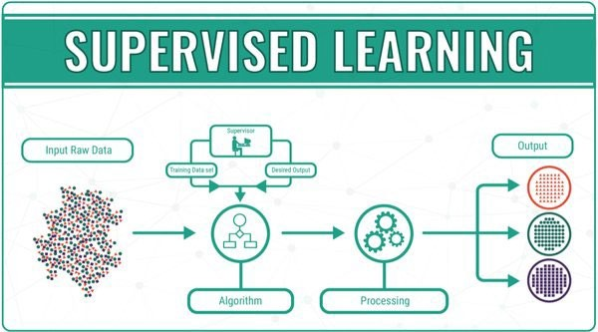
Three Main Types of Machine Learning
Courtesy: https://bigdata-madesimple.com/machine-learning-explained-understanding-supervised-unsupervised-and-reinforcement-learning/

Slide 7
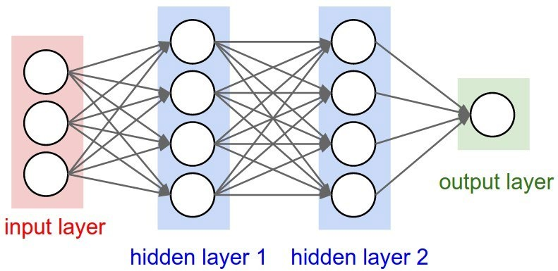
So what is a Deep Neural Network?
Example of a 3-layer Deep Neural Network (DNN) – (input layer is not counted)
Courtesy: http://cs231n.github.io/neural-networks-1/

Slide 8
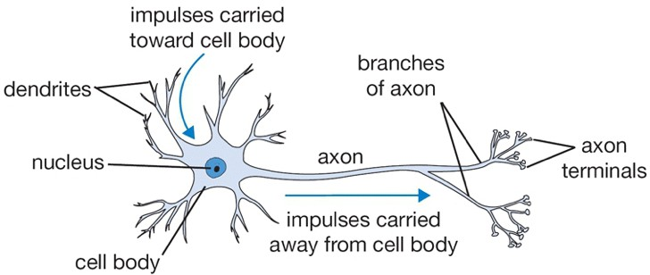
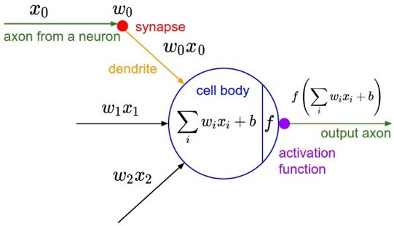
Graphical/Mathematical Intuitions for DNNs
Drawing of a Biological Neuron
The Mathematical Model
Courtesy: http://cs231n.github.io/neural-networks-1/

Slide 9
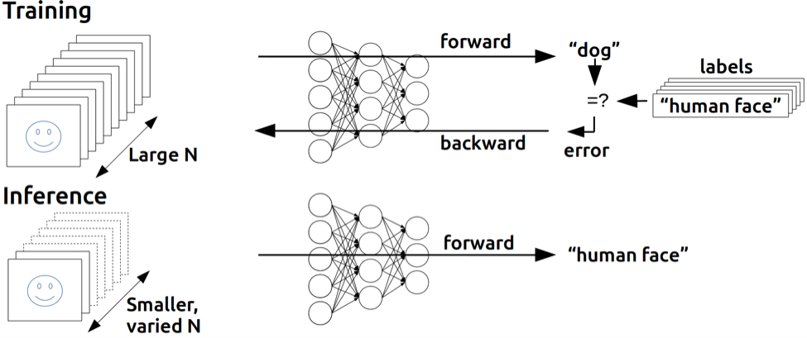
Key Phases of Deep Learning
Training is compute intensive
Many passes over data
Can take days to weeks
Model adjustment is done
Inference
Single pass over the data
Should take seconds
– No model adjustment
Challenge: How to make “Training” faster?
– Need Parallel and Distributed Training…
Courtesy: https://devblogs.nvidia.com/

Slide 10
Understand DNN Applications:
An Overview of Deep Learning Models
Convolutional Neural Networks
Recurrent Neural Networks
Transformers
Graph Neural Networks
Mixture-of-Experts

Slide 11
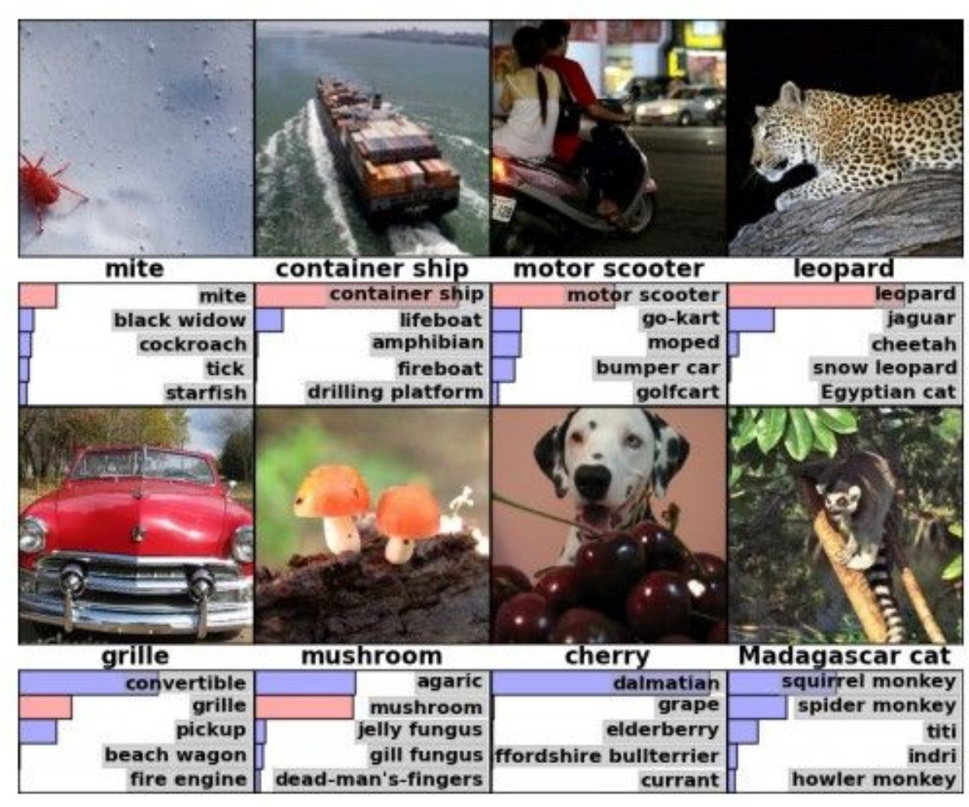
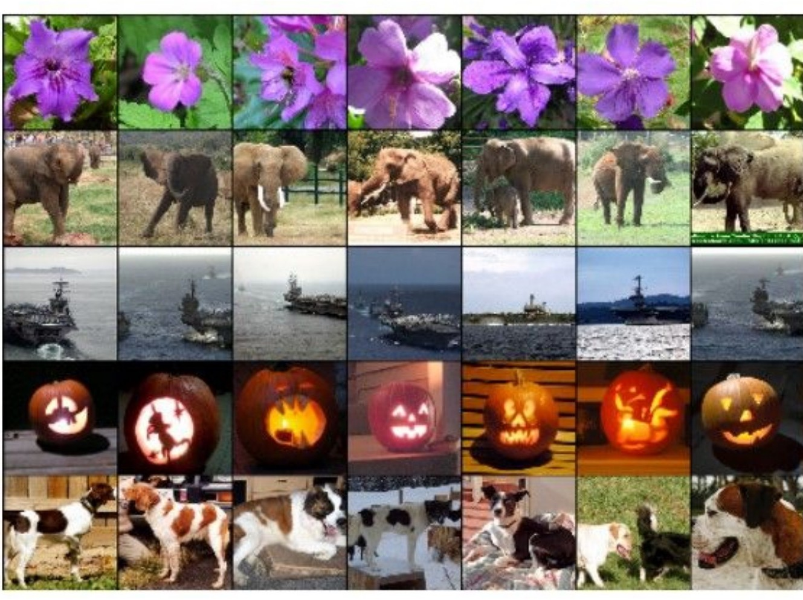
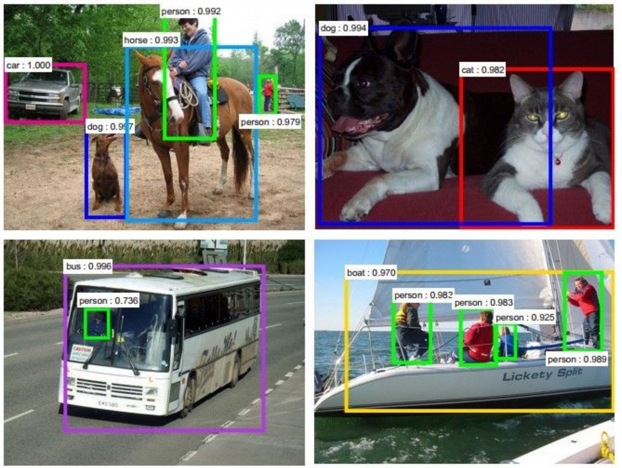
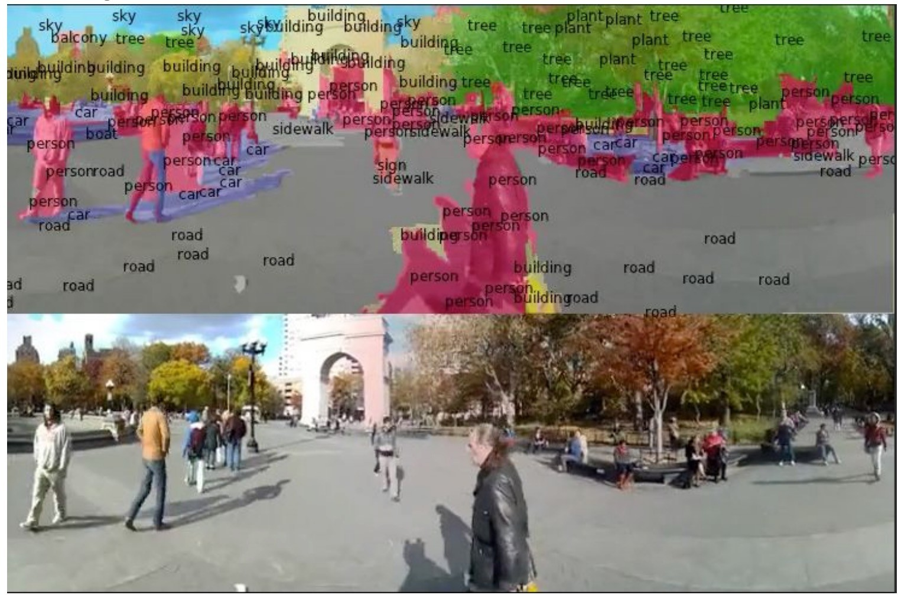
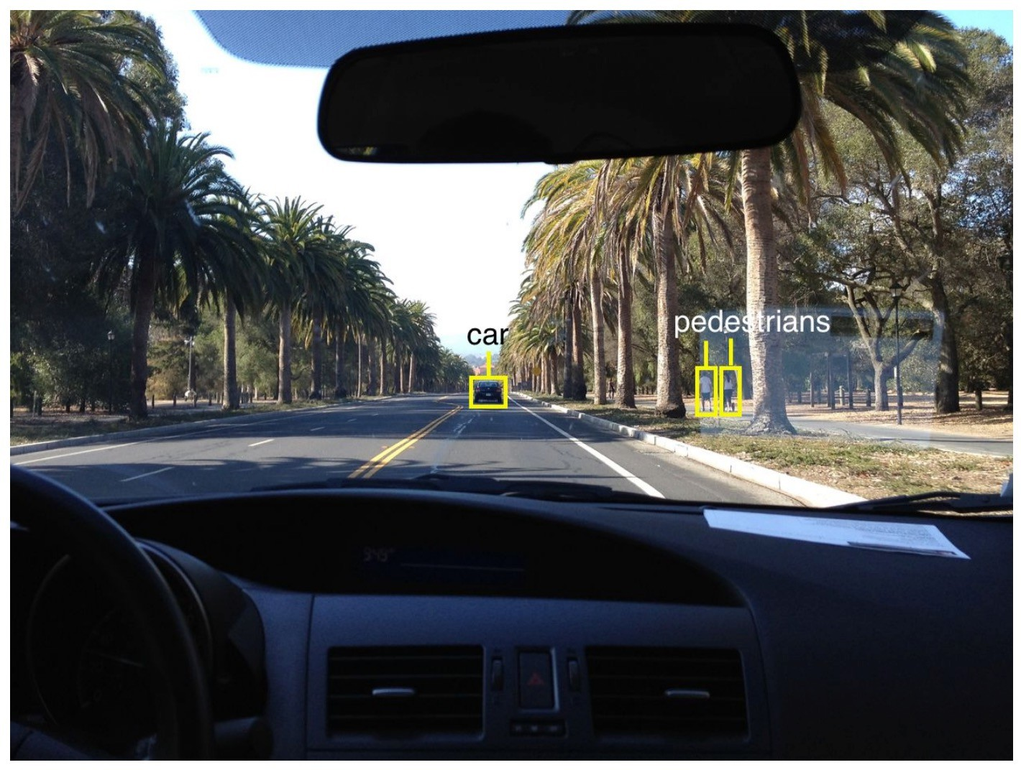
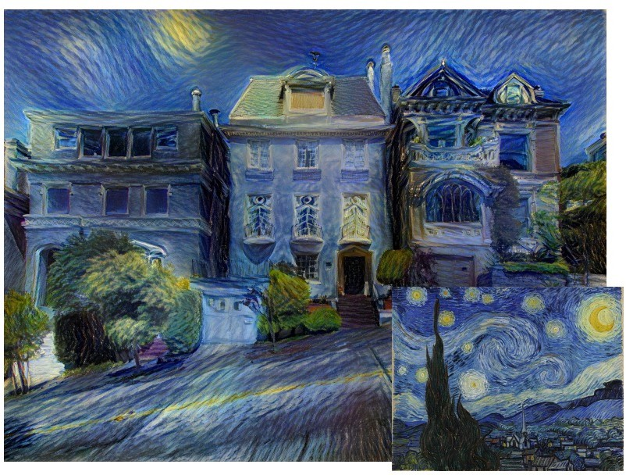
CNNs are widely used in vision tasks
Classification
Retrieval
Detection
Segmentation
Self-Driving
Synthesis

Slide 12
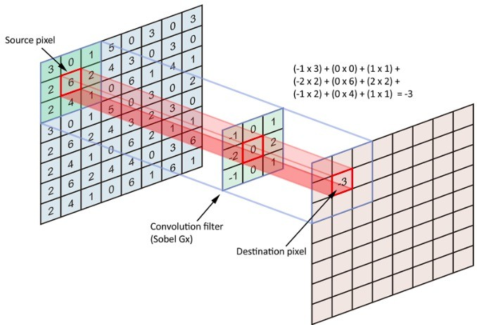
Recap: Convolution
Convolve the filter with the image: slide over the image spatially and compute dot products

Slide 13
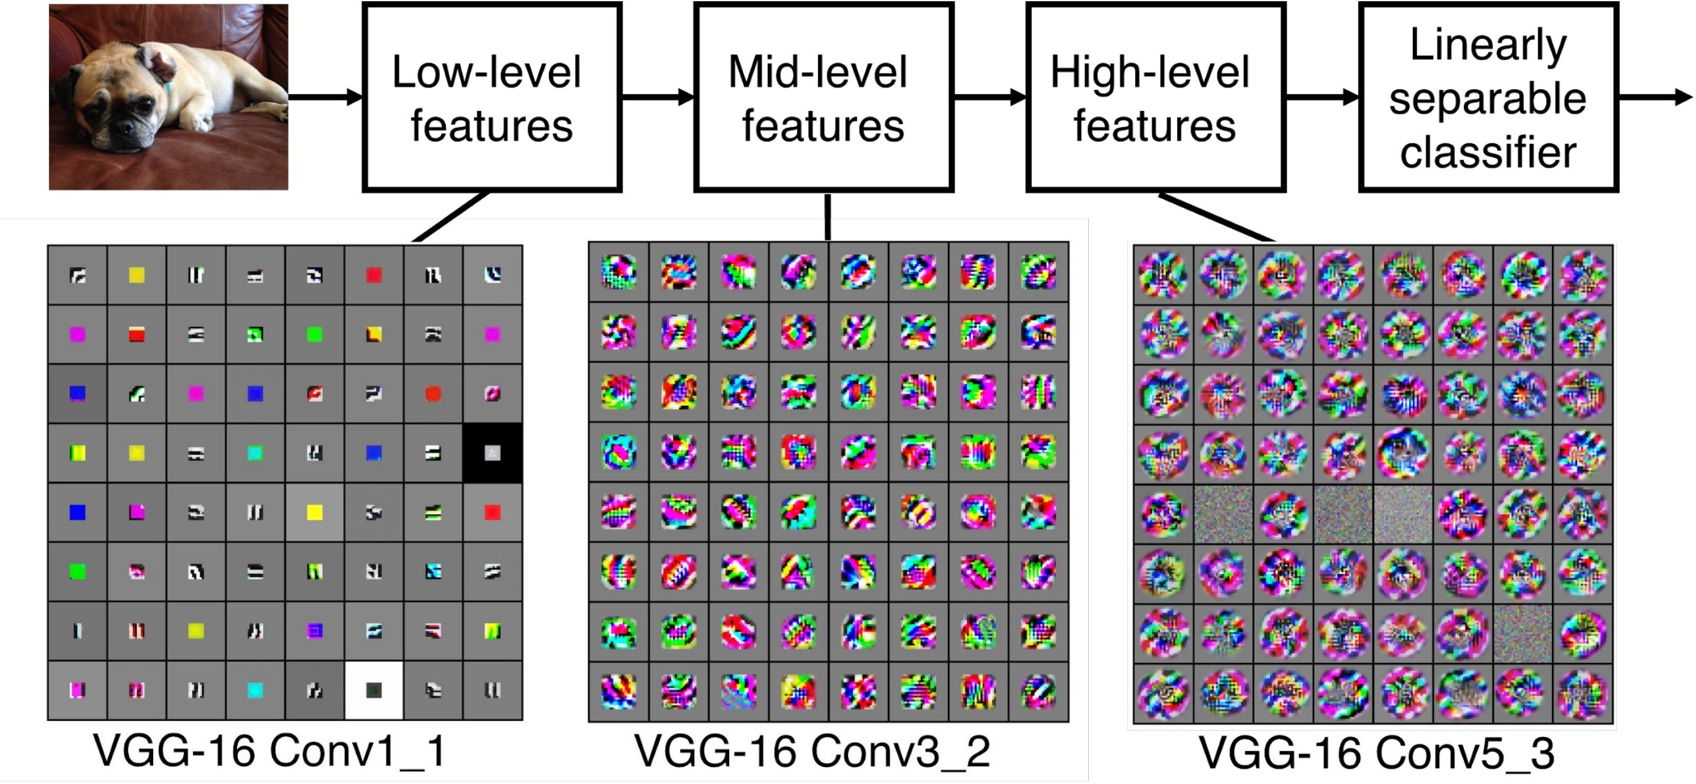
CNNs
A sequence of convolutional layers, interspersed by pooling, normalization, and activation functions
[Zeiler and Fergus 2013]

Slide 14
Computation Challenges in CNNs:
- Increasing Computational Requirements
16
14
12
10
8
6
4
2
0
300
264
Number of Samples (in Millions)
14.1
250
Number of Layers
200
152
150
102
100
50
12
19
1.4
0
0.06
VGG (2014)
ResNet (2015)
CIFAR10
AlexNet (2012)
Inception (2015)
DenseNet (2016)
ImageNet-1K
ImageNet-22K

Slide 15
Understand ML Applications:
An Overview of Deep Learning Models
Convolutional Neural Networks
Recurrent Neural Networks
Transformers
Graph Neural Networks
Mixture-of-Experts

Slide 16
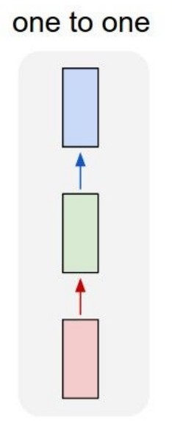
Recurrent Neural Networks: Process Sequences
Vanilla Neural Networks

Slide 17
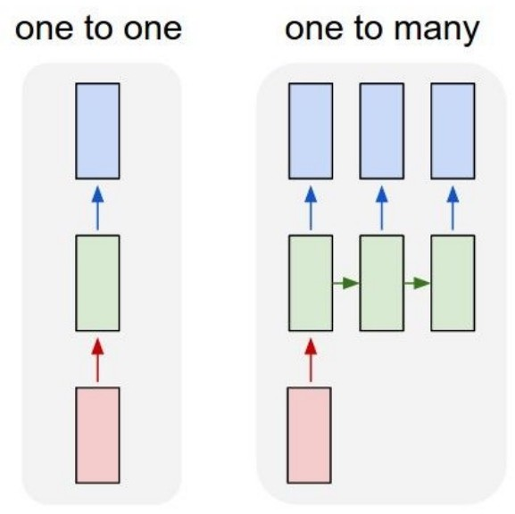
Recurrent Neural Networks: Process Sequences
e.g., image captioning Image -> sequence of words

Slide 18
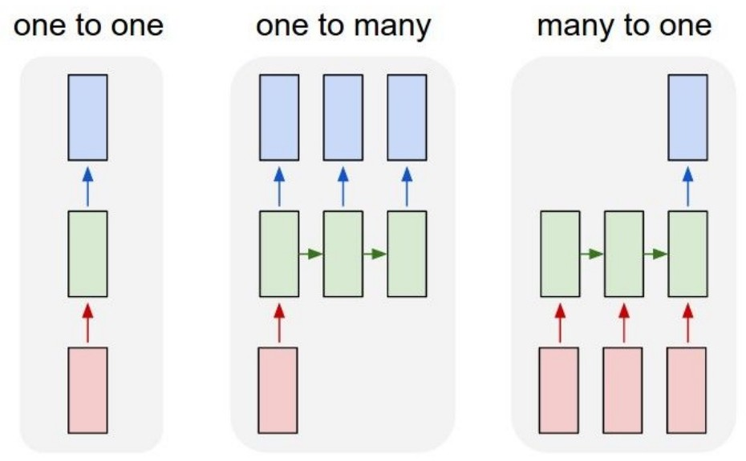
Recurrent Neural Networks: Process Sequences
e.g., action prediction
sequence of video frames -> action

Slide 19
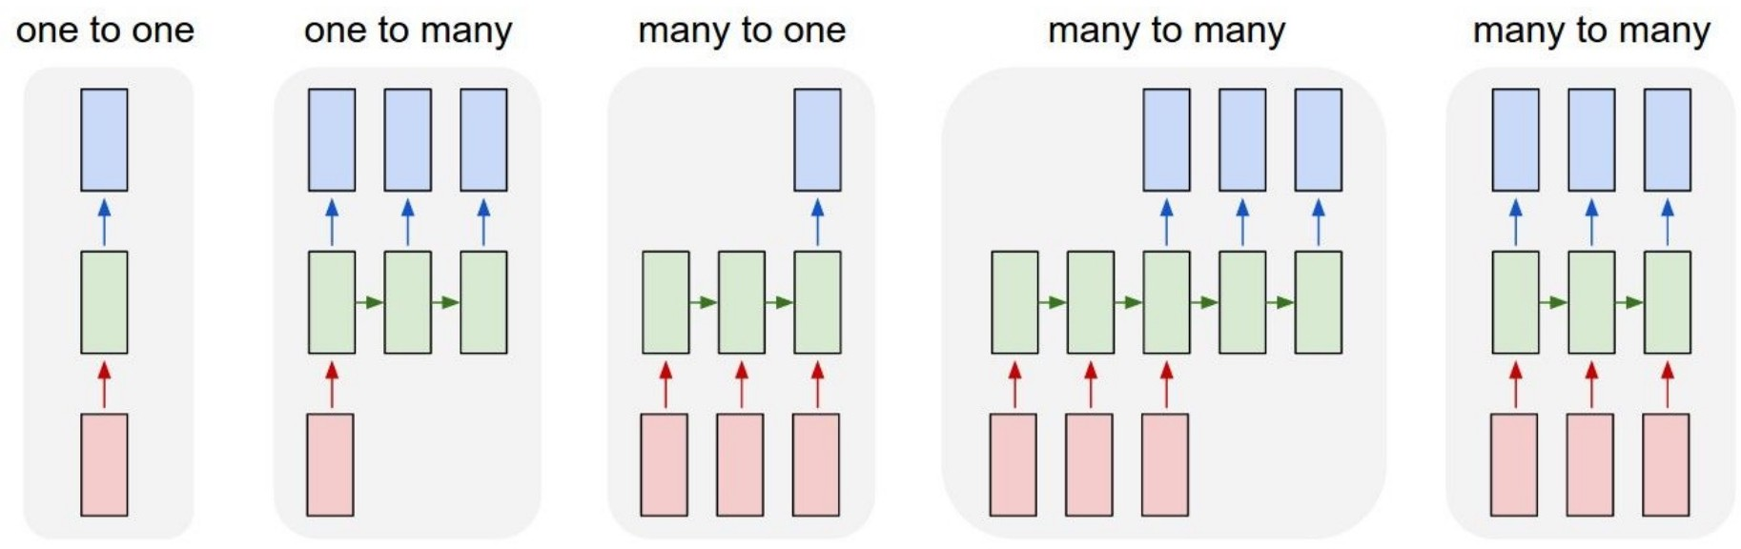
Recurrent Neural Networks: Process Sequences
Recurrent Neural Networks: Process Sequences
Video captioning: sequence of video frames -> sequence of words Machine translation
Video classification on frames

Slide 20
Recurrent Neural Networks
outputs[i]
Arbitrary number of outputs
Recurrent Neural Networks
Key idea: RNNs have an internal state that is updated as a sequence is processed
inputs[i]
Arbitrary number of inputs

Slide 21
How to Represent RNNs in Computation Graphs
Computation graphs must be direct acyclic graphs (DAGs) but RNNs have self loops
Solution: unrolling RNNs (define maximum depth)
output₀
output₁
output₂
output_{n}
RNN
RNN
RNN
RNN
state₀
state₁
state₂
state_{n}
input₀
input₁
input₃
input_{n}

Slide 22
When do we need RNNs?
RNNs are designed to process sequences (texts, videos)
RNNs are extremely useful when you want your model to have internal states when a sequence is processed
Commonly used in reinforcement learning (RL)

Slide 23
Understand ML Applications:
An Overview of Deep Learning Models
Convolutional Neural Networks
Recurrent Neural Networks
Transformers
Graph Neural Networks
Mixture-of-Experts

Slide 24
Inefficiency in RNNs?
Problem: lack of parallelizability. Both forward and backward passes have O(sequence length) unparallelizable operators
A state cannot be computed before all previous states have been computed
Inhibits training on very long sequences
output₀
output₁
output₂
output_{n}
RNN
RNN
RNN
RNN
state₀
state₁
state₂
state_{n}
input₀
input₁
input₃
input_{n}

Slide 25
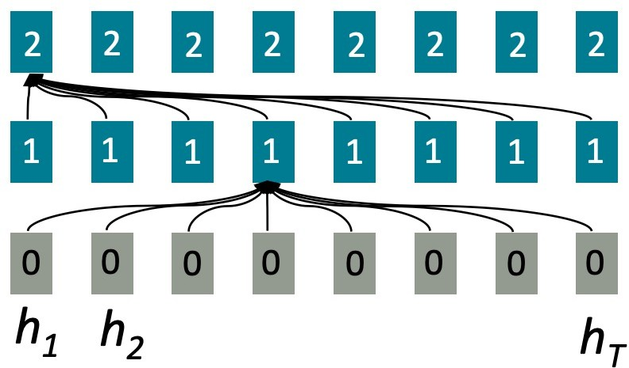
Attention: Enable Parallelism within a Sequence
Idea: treat each position’s representation as a query to access and incorporate information from a set of values
Attention Layer 2
Attention Layer 1
Layer 0

Slide 26
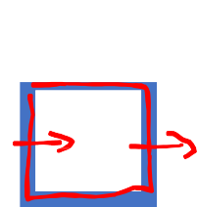



Attention: Enable Parallelism within a Sequence
Idea: treat each position’s representation as a query to access and incorporate information from a set of values
Massively parallelizable: number of unparallelizable operations does not increase sequence length
We will learn attention and
Attention Layer 2
transformers in depth later:
Self-attention
Masked attention
Multi-head attention
query
Attention Layer 1
Layer 0
values

Slide 27
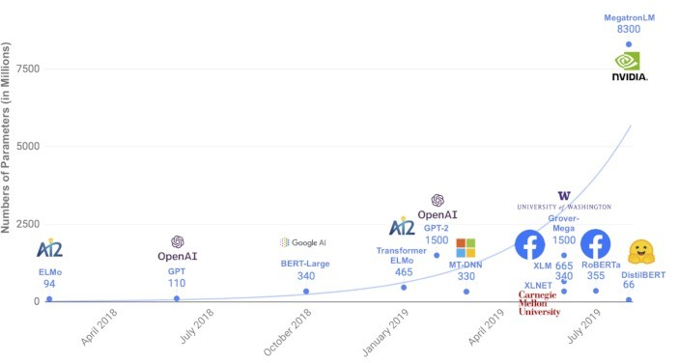
Challenges: Exponentially Increasing - Computational Costs for Transformer Models
We have seen similar trend in CNNs before.

Slide 28
Understand ML Applications:
An Overview of Deep Learning Models
Convolutional Neural Networks
Recurrent Neural Networks
Transformers
Graph Neural Networks
Mixture-of-Experts

Slide 29
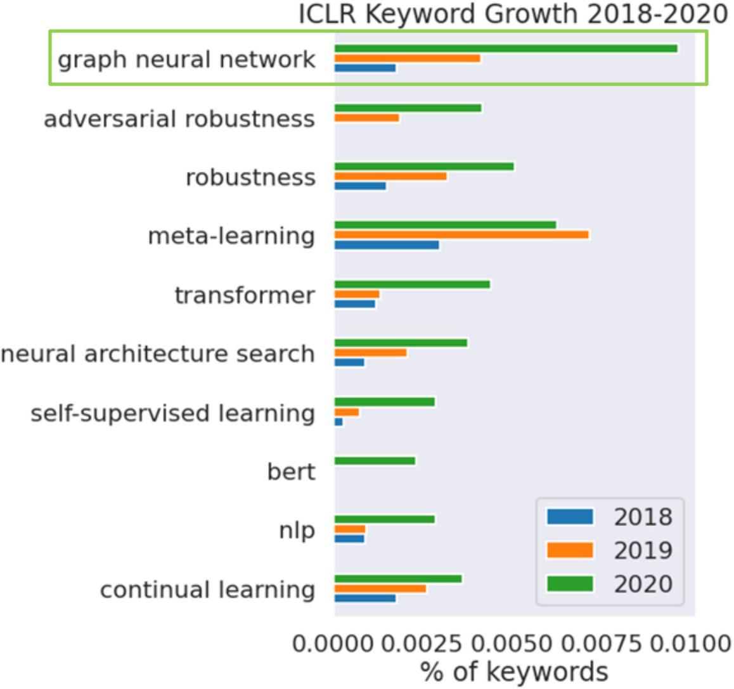
Graph Neural Networks: The Hottest Subfield in ML

Slide 30
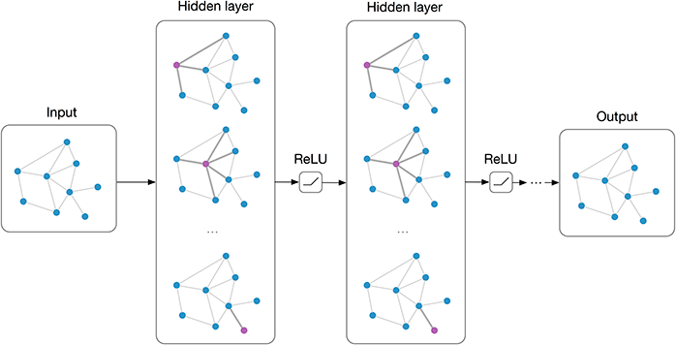
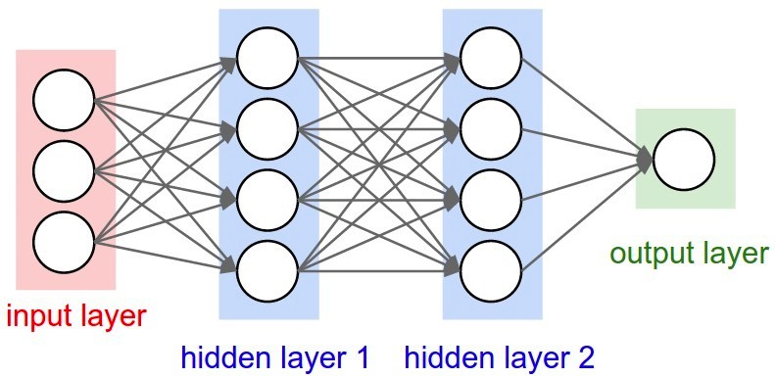
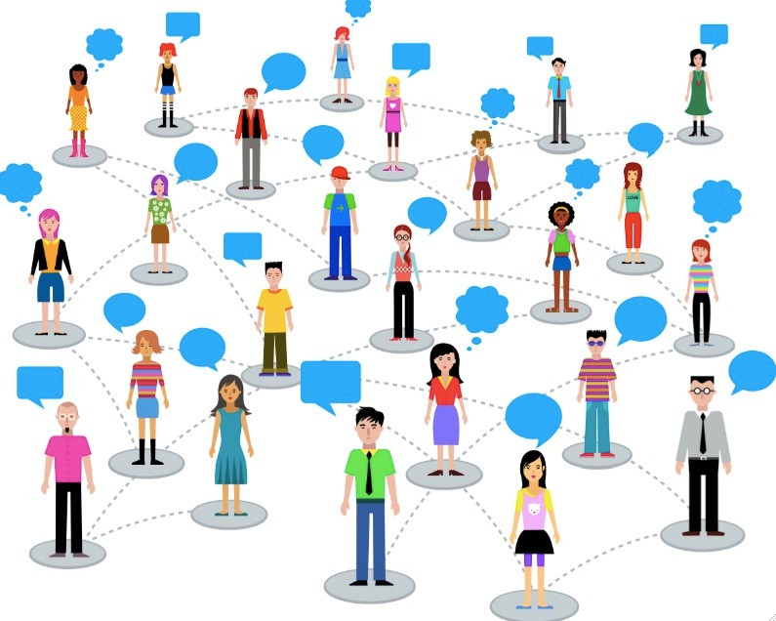
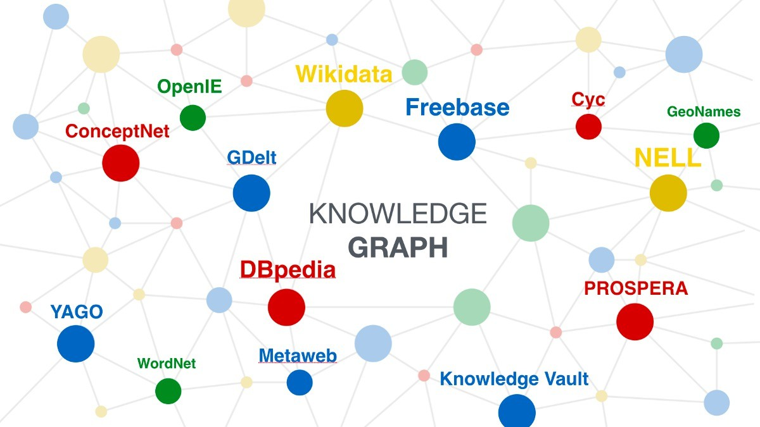
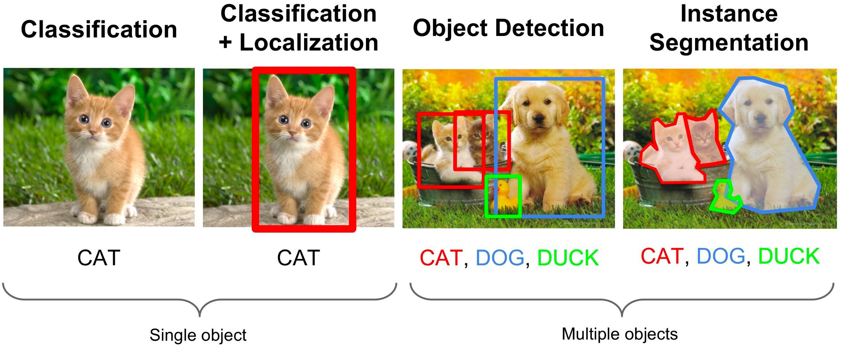

GNNs: Neural Networks on Relational Data
Neural Networks
Graph Neural Networks

Slide 31





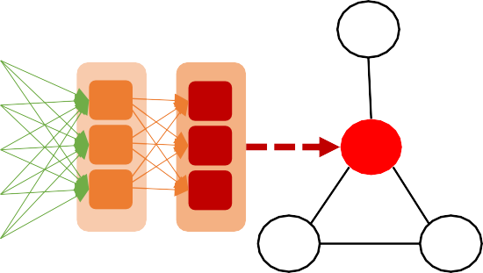




Graph Neural Network Architecture
Combine graph propagation w/ neural network operations
New Representations
A
Input Representations
Target vertex Neighbors
B
A
Aggregation
(sum, LSTM, …)
C
D
Neighbor Aggregation
DNN Operations

Slide 32
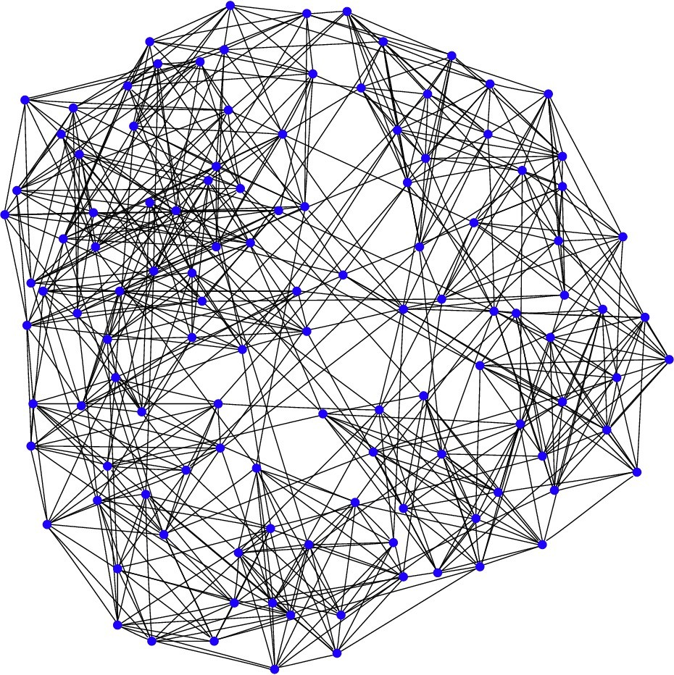








Challenges of GNN Computations on GPUs
Neural Networks Graph Neural Networks
Small and regular intermediate data
Large and irregular intermediate data
Efficiency & scalability challenges
Good efficiency

Slide 33
Understand ML Applications:
An Overview of Deep Learning Models
Convolutional Neural Networks
Recurrent Neural Networks
Transformers
Graph Neural Networks
Mixture-of-Experts

Slide 34

Mixture-of-Experts
Key idea: make each expert focus on predicting the right answer for a subset of cases

Slide 35

Switch Transformers = Transformers + Mixture of Experts

Slide 36
Takeaways:
Convolutional neural networks: various computer vision tasks
Recurrent neural networks: processing sequences
Transformers: efficient natural language processing
Graph neural networks: deep learning on relational data
Mixture of experts: ensemble deep learning
A key takeaway: DNN techniques are not applied in isolation. Solving real- world problems require ``clever’’ integration of DNN techniques

